Slide 1
Outline
Introduction
Skill & Talent
Research Experience
01
02
03
Industry Research
Future Research Interests
04
05

Slide 2
Introduction
TIANQI YU
Birth: 1997/11/20
Birthplace: Harbin
Current Location: Nanjing
2016 - 2020
Mobileye
2021 - 2022
DiDi
2023 - Current
TJUT
2019
UoM
2022
China Unicom
TOEFL 2018
GRE 2019
TIANJIN VICO 2020

Slide 3
Introduction
01
Exploration
Why PhD
02
Curiosity
03
Opportunities

Slide 4
Skills & Talent
CV
01
NLP
02
LLM
03
Object Detection
Multi-Object Tracking
MMLM
Text Summarization
Text Classification
Semi-supervised Learning
Pre-training
Fine-Tuning
Inference, RAG
Backend
04
Others
05
Certificate
06
Spring Boot, Spring MVC
Django, Flask, FastApi
Docker
Kubernetes
Cloud Production
AWS Cloud Practitioner
Artificial Intelligence Engineer Senior - MIIT

Slide 5


Research Experience
Paper
01
Large Language Models in Intelligent Service System, Ticket Classification:
Evaluation, Analysis and Distillation
Research Project
02
Z3 Rule-Based Multi-Step Reasoning: DAG-Driven Dataset Generation
With Variable and Semantic Constraints

Slide 6
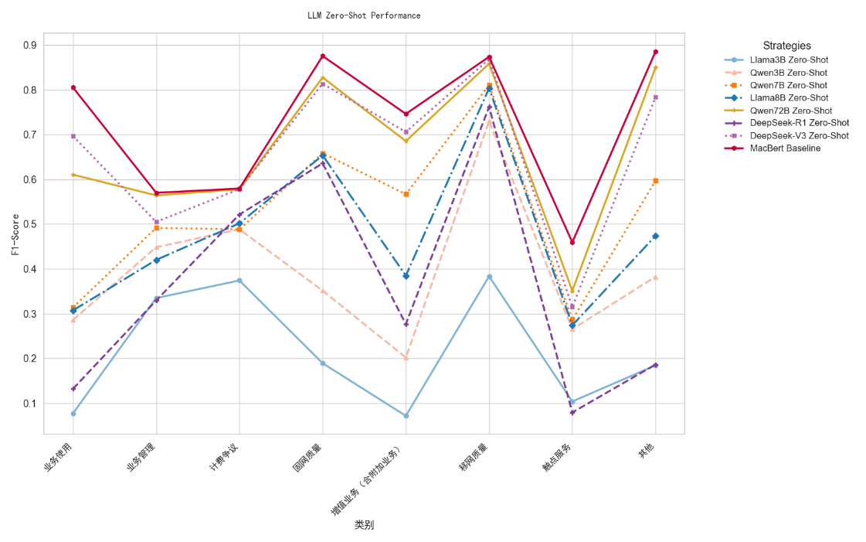
Research Experience 1
Large Language Models in Intelligent Service System: Evaluation, Analysis and Distillation
What we do?
Eval multiple popular LLM on domain-specific task, telecom ticket classification
Conduct an eval pipeline integrates quantitative metrics and task-specific requirements
Analyze different prompt strategies on industrial dataset
Ablation Study on different prompt strategies
Explore knowledge distillation and re-eval
Why we do this?
Huge gap between academic & industrial dataset
Rapid evolution of LLM capabilities
Clarifying LLMs in telecom customer service
What we conclude
LLM+zero-shot+plain prompt doesn’t work
Few-shot improves accuracy under limited samples, but still has limitation
Mutual Exclusion + Boundary Condition + Few-shot work!
Distilling small-parameter LLM with few hundreds data surpasses ten billions LLM
Notes:
Large Language Models in Intelligent Service System: Evaluation, Analysis and Distillation——Introduction & Motivation & Contribution

Slide 7
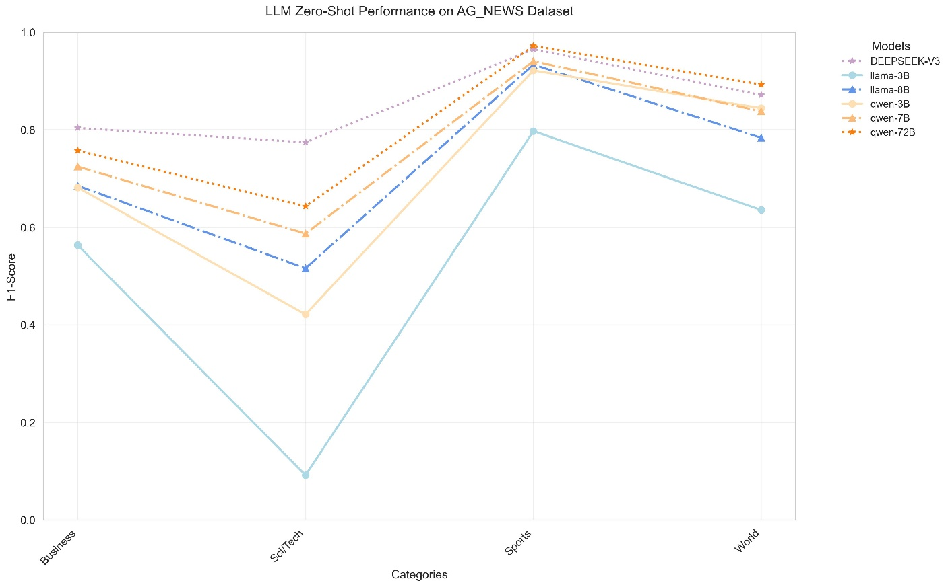
Research Experience 1
Large Language Models in Intelligent Service System: Evaluation, Analysis and Distillation
Notes:
Large Language Models in Intelligent Service System: Evaluation, Analysis and Distillation——Introduction & Motivation & Contribution

Slide 8
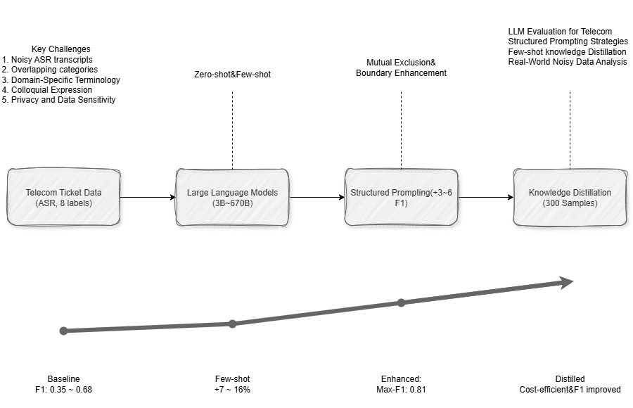
Research Experience 1
Notes:
Large Language Models in Intelligent Service System: Evaluation, Analysis and Distillation——Methodology, Evaluation

Slide 9
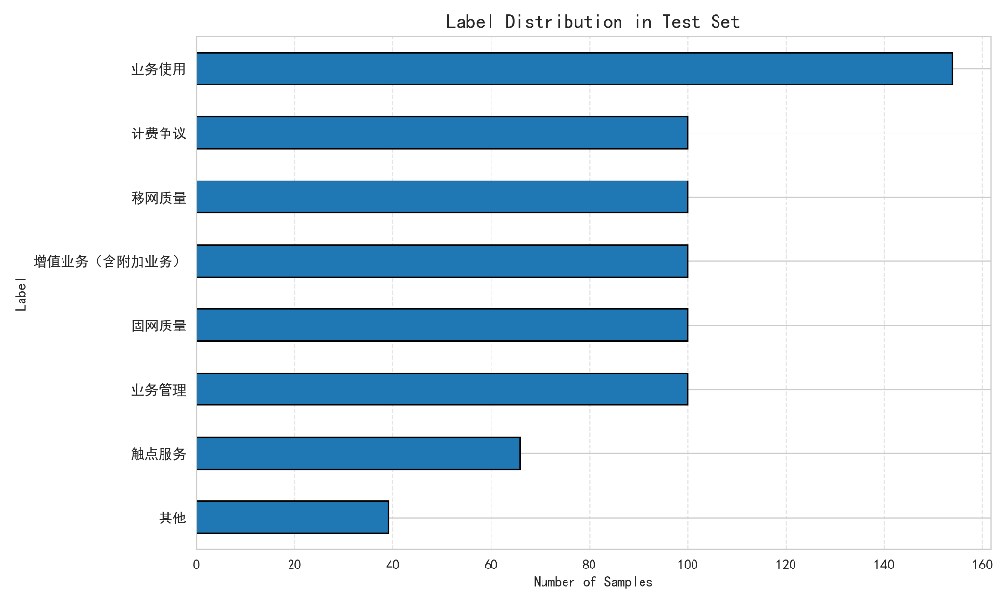
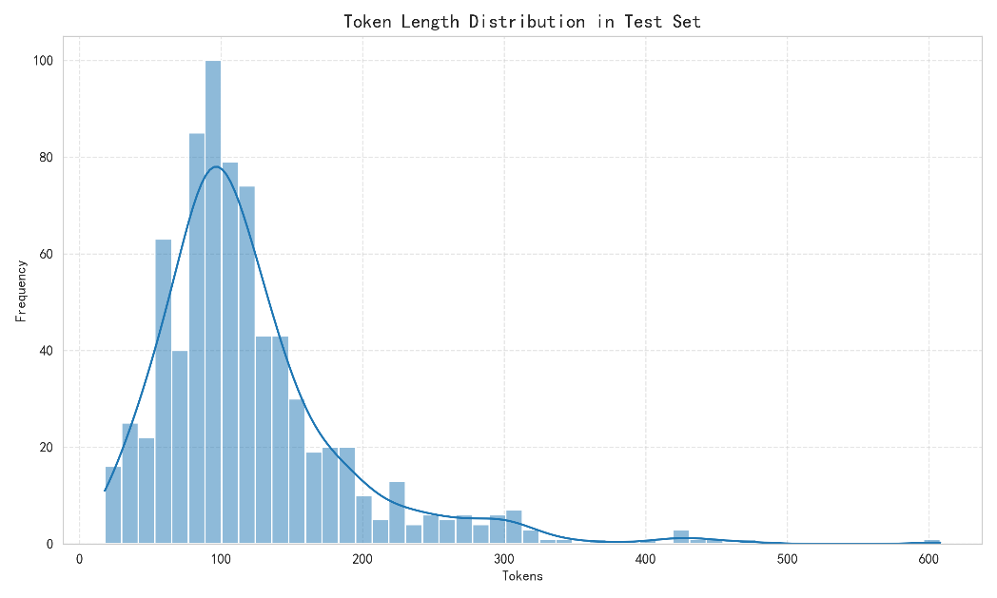
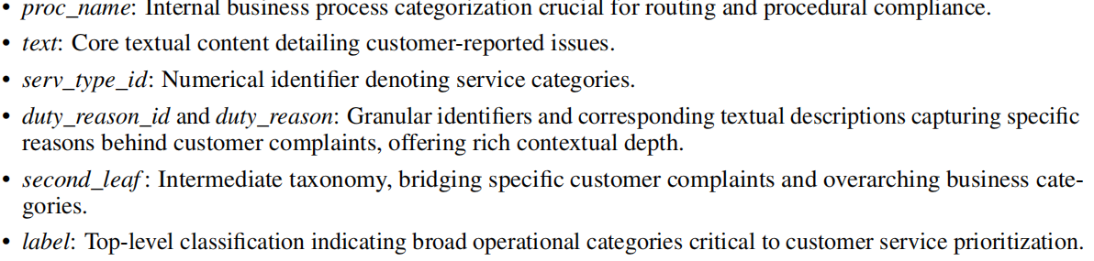
Research Experience 1
Notes:
Large Language Models in Intelligent Service System: Evaluation, Analysis and Distillation——Methodology, Evaluation

Slide 10
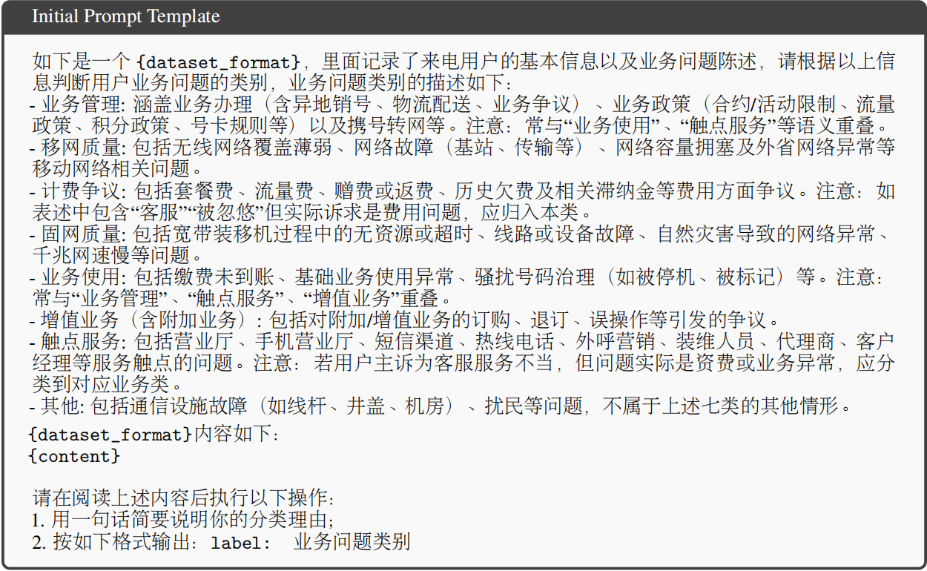
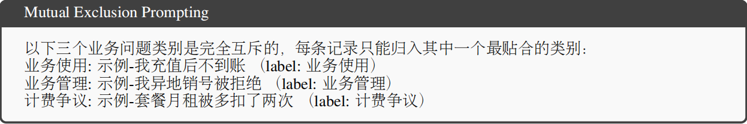
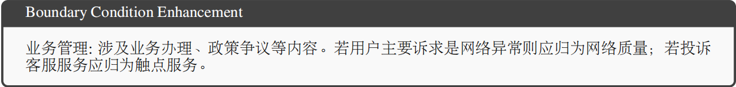
Research Experience 1
Notes:
Large Language Models in Intelligent Service System: Evaluation, Analysis and Distillation——Methodology, Evaluation

Slide 11
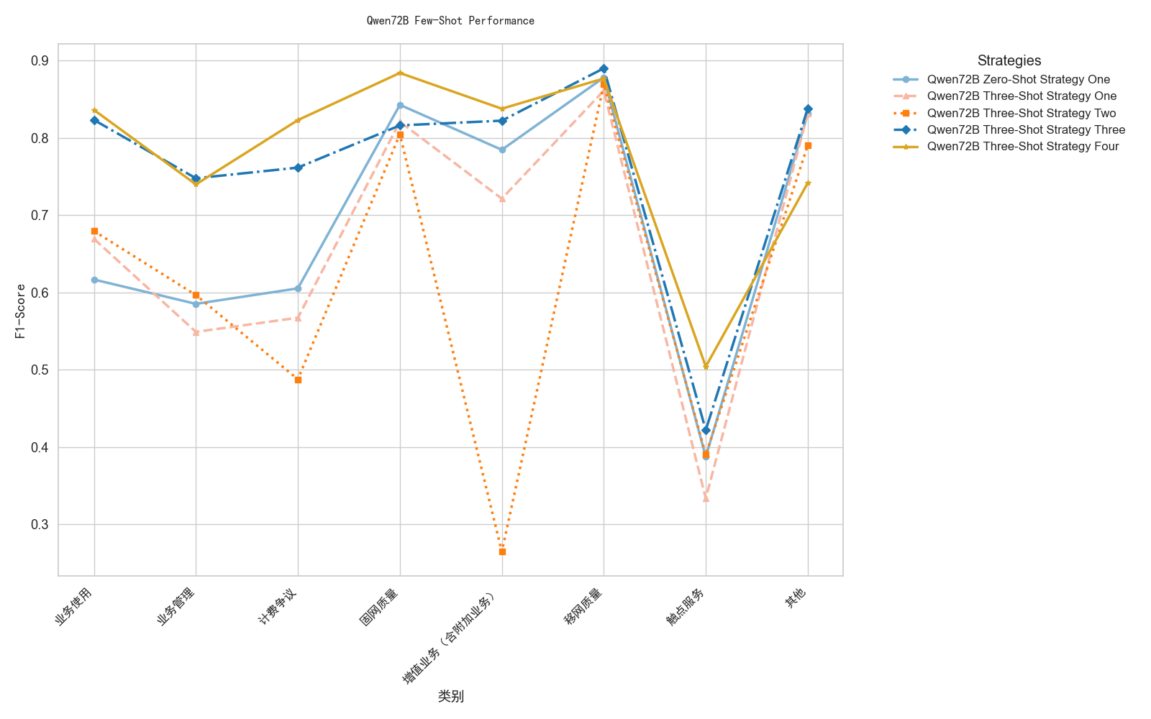
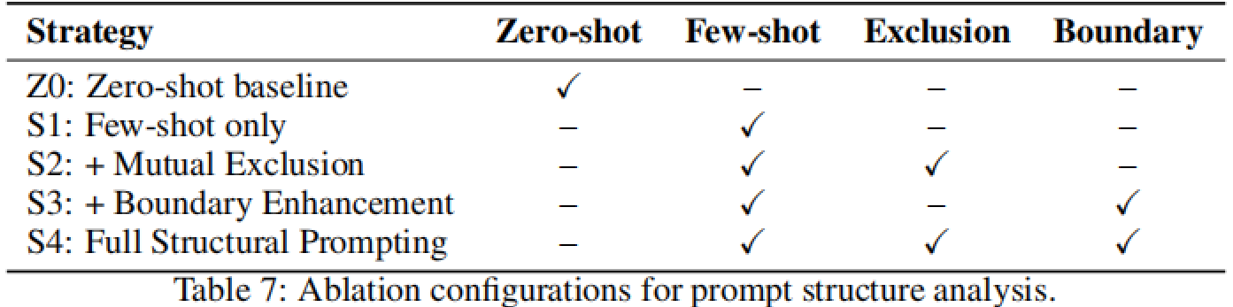
Research Experience 1
Notes:
Large Language Models in Intelligent Service System: Evaluation, Analysis and Distillation——Methodology, Evaluation

Slide 12
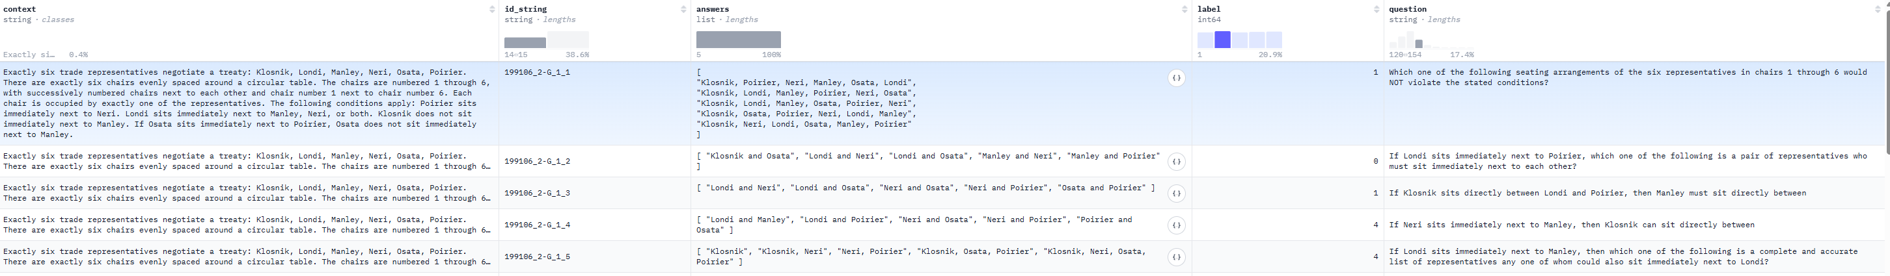
Research Experience 2
Z3 Rule-Based Multi-Step Reasoning: DAG-Driven Dataset Generation With Variable and Semantic Constraints
What we do?
Produced LSAT-style logical reason datasets for LLM training and eval
Why we do this?
Limitations in Reasoning
Training Data Quality Issues
Controllability and Interpretability
What is it like?
AR-LSAT
Notes:
Z3 Rule-Based Multi-Step Reasoning: DAG-Driven Dataset Generation With Variable and Semantic Constraints —— Introduction, Motivation, Contribution

Slide 13
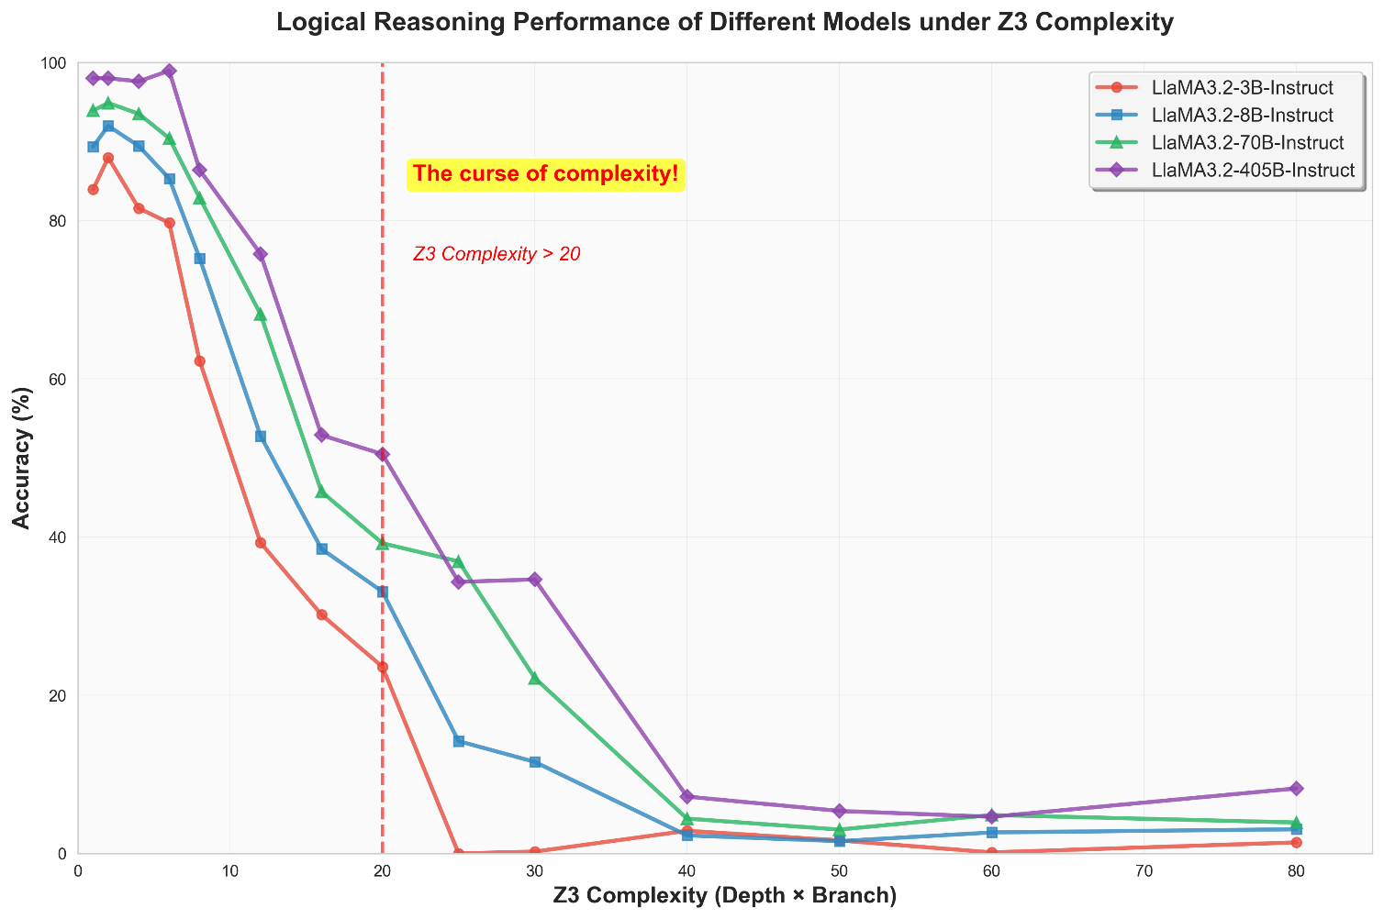
Research Experience 2
GPT-4o
64.2% in FOLIO
33% in LSAT-logic games
On LogiGLUE, GPT-4o achieves 73.59% on deductive reasoning
But only 31.55% on inductive tasks
Notes:
Z3 Rule-Based Multi-Step Reasoning: DAG-Driven Dataset Generation With Variable and Semantic Constraints —— Methodology

Slide 14
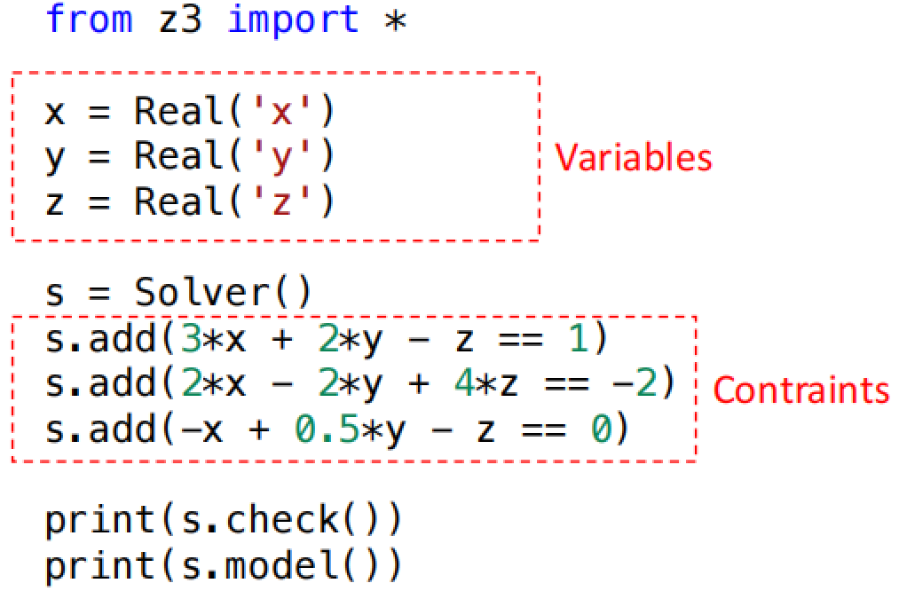
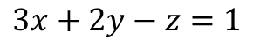
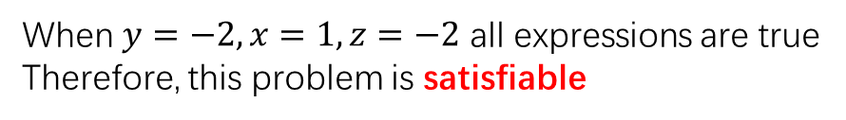
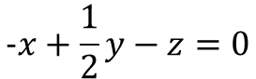
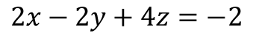
Research Experience 2
Z3 Theorem Prover, is a satisfiability modulo theories(SMT) solver developed by Microsoft
$$3x+2y−z=1$$
When $y=−2, x=1, z=−2$ all expressions are true
Therefore, this problem is satisfiable
$$2x−2y+4z=−2$$
$$−x+\frac{1}{2}y−z=0$$
Notes:
Z3 Rule-Based Multi-Step Reasoning: DAG-Driven Dataset Generation With Variable and Semantic Constraints —— Introduction, Motivation, Contribution

Slide 15
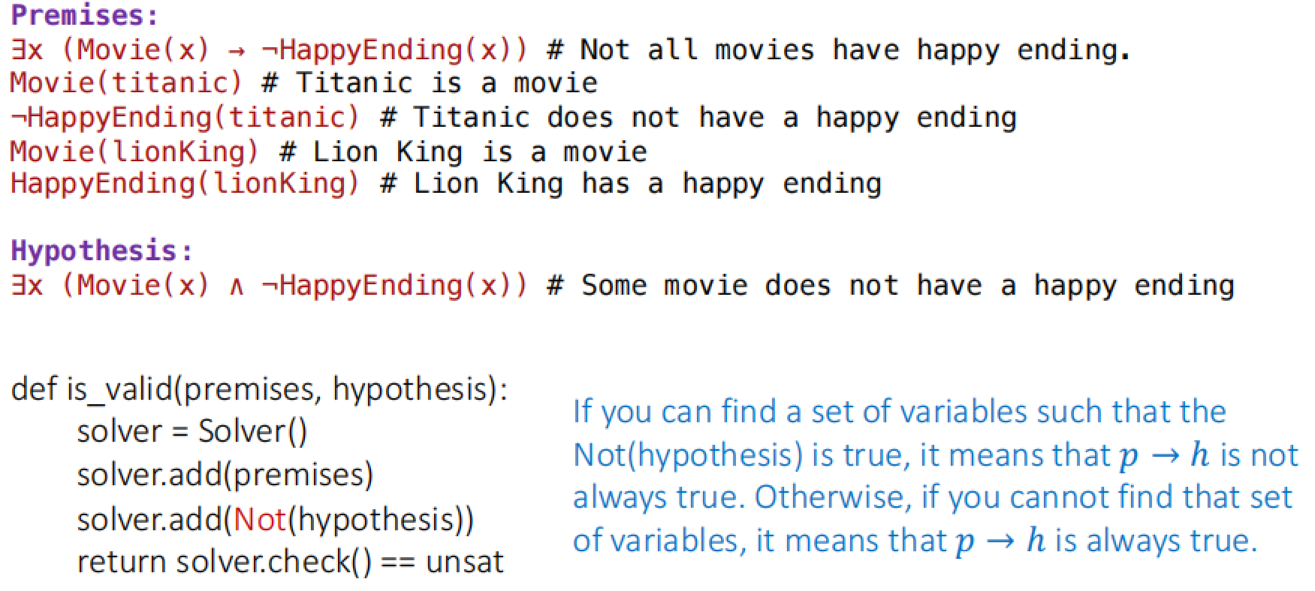
Research Experience 2
Notes:
Z3 Rule-Based Multi-Step Reasoning: DAG-Driven Dataset Generation With Variable and Semantic Constraints —— Introduction, Motivation, Contribution

Slide 16
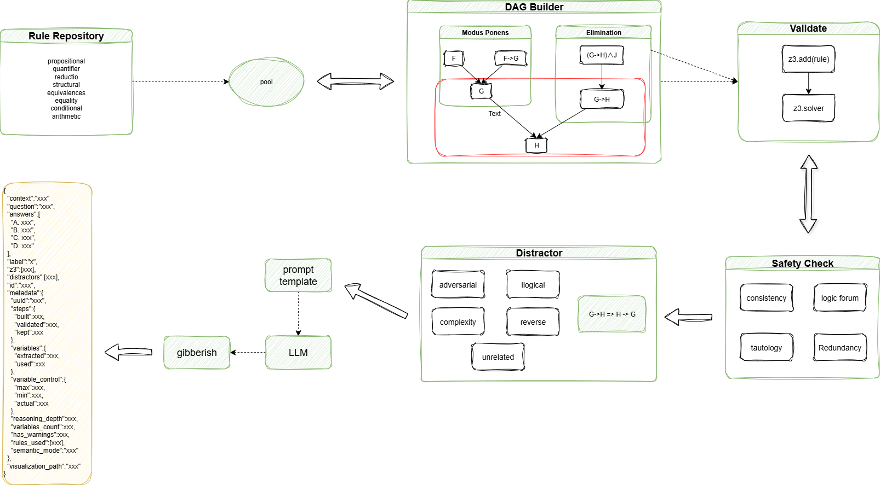
Research Experience 2
Notes:
Z3 Rule-Based Multi-Step Reasoning: DAG-Driven Dataset Generation With Variable and Semantic Constraints —— Implementation

Slide 17
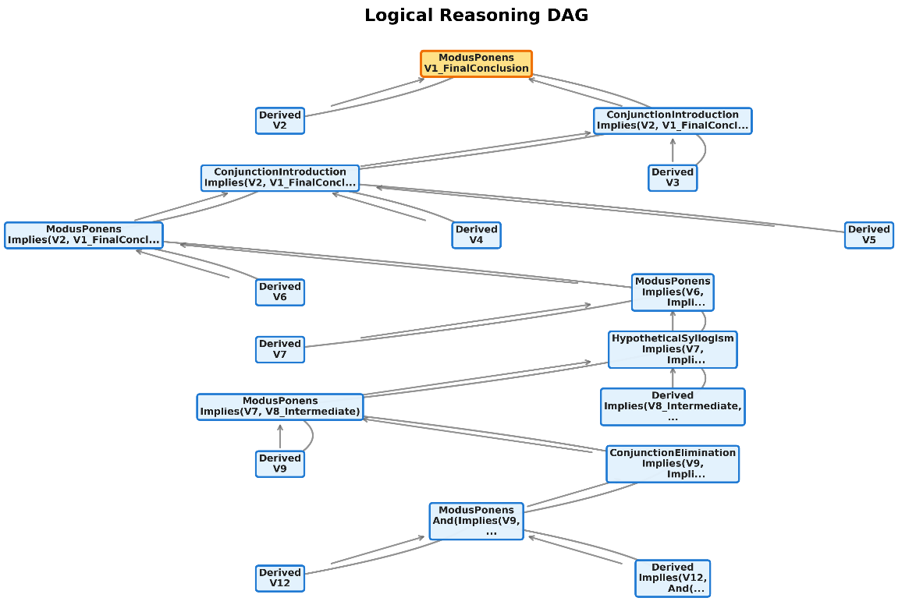
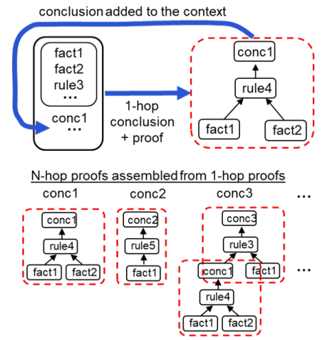


Research Experience 2
Notes:
Z3 Rule-Based Multi-Step Reasoning: DAG-Driven Dataset Generation With Variable and Semantic Constraints —— Introduction, Motivation, Contribution

Slide 18
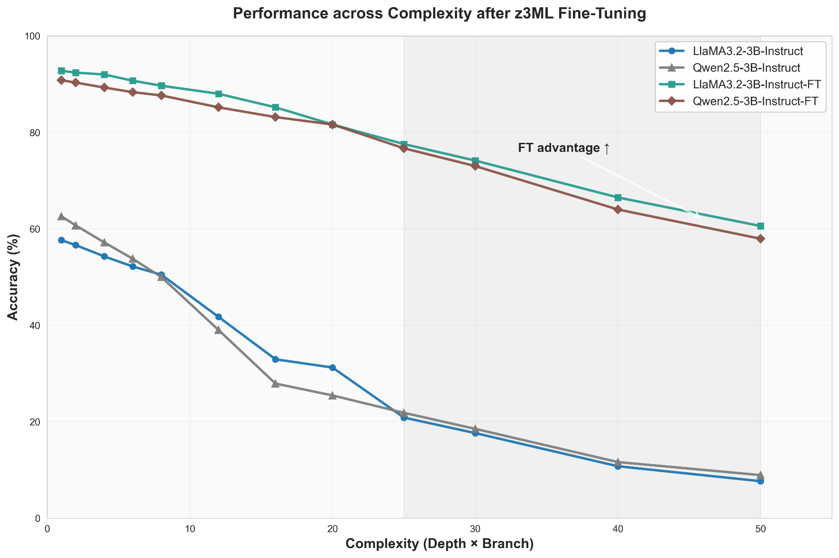
Research Experience 2
1000 sample data, including:
Biconditional Elimination
Conjunction Introduction
Conjunction Elimination
Disjunction Introduction
Hypothetical Syllogism
Modus Ponens
Transitivity
Universal Instantiation
Notes:
Z3 Rule-Based Multi-Step Reasoning: DAG-Driven Dataset Generation With Variable and Semantic Constraints —— Implementation

Slide 19
Industry Experience
Industry Project1
01
Multimodal image-text understanding and Knowledge Retrieval
Industry Project2
02
Small-parameter Large Language Model: Pre-training and Fine-Tuning

Slide 20
Industry Experience 1
Multimodal image-text understanding and Knowledge Retrieval
Traditional RAG: OCR Chunks Embedding Recall & Re-rank
Something is lost: Layout, Table Structure, Images, Hyperlink…
What we really like! Layout, charts, tables, fonts, and other visual cues remains semantically consistent!
What we really want
Faster!
Precise
Various Input formula
Stability
Generalization
Notes:
Multimodal image-text understanding and Knowledge Retrieval —— Overview

Slide 21
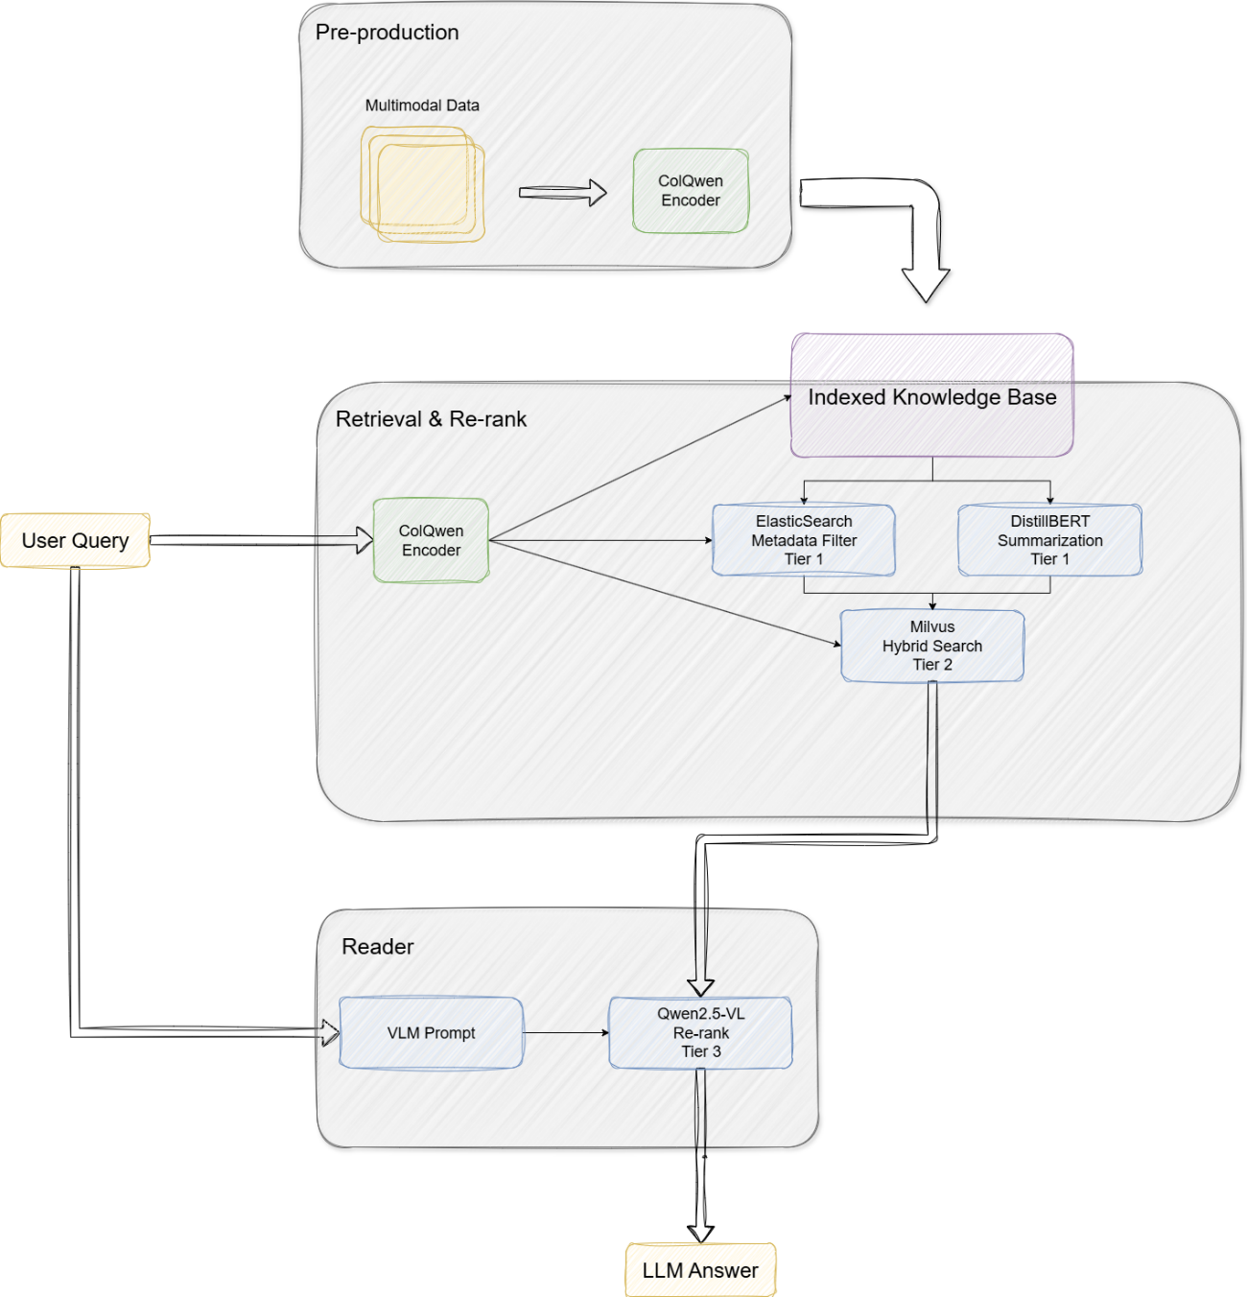
Industry Experience 1
User Input: Query + Doc
Embedding: Token-level/patch-level vector
Tier 1
Meta Filter: keywords, timestamp, partition, etc
Summarization: offline doc text summarization
Tier 2
Late Interaction
Hybrid Search: HNSW+IVF-Q
Tier 3
Qwen-VL: image understanding + score
Notes:
Multimodal image-text understanding and Knowledge Retrieval —— Achievements, Contribution

Slide 22
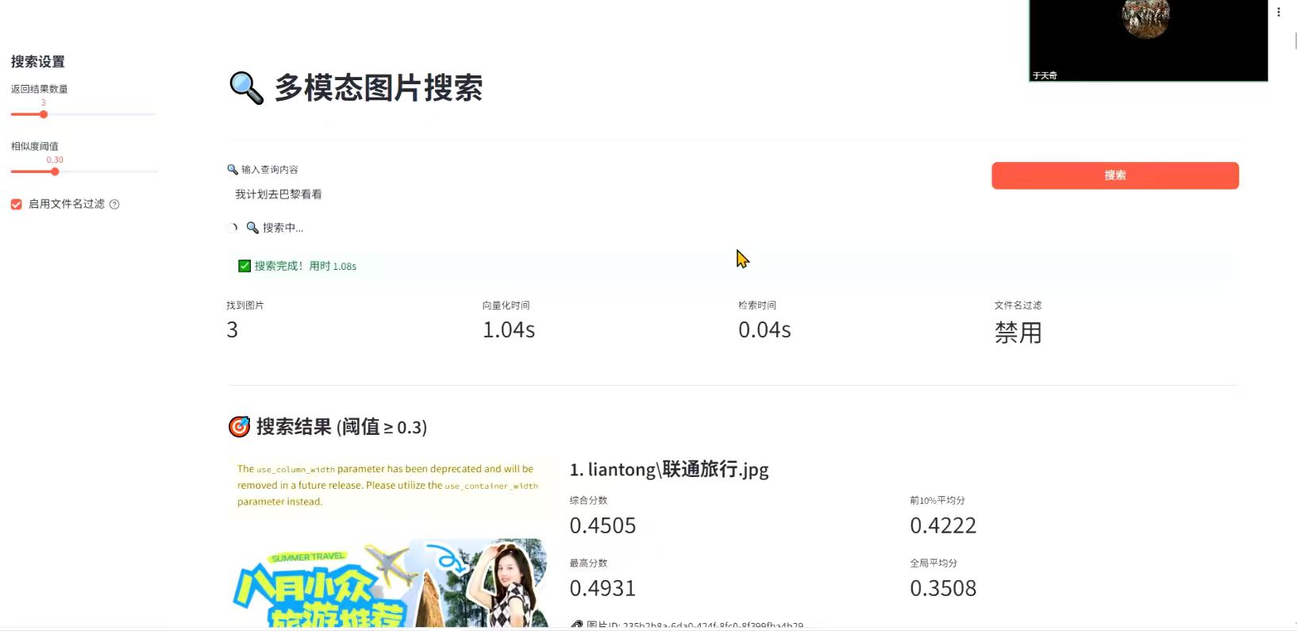
Industry Experience 1
Compared to traditional solution:
Recall@10: 27% Improved
nDCG@10: 13% Improved
Average latency: 35% Saved
In financial Auditing/industrial maintenance: (compare to ColPali 8% Recall Improved)
Notes:
Multimodal image-text understanding and Knowledge Retrieval —— Techology

Slide 23
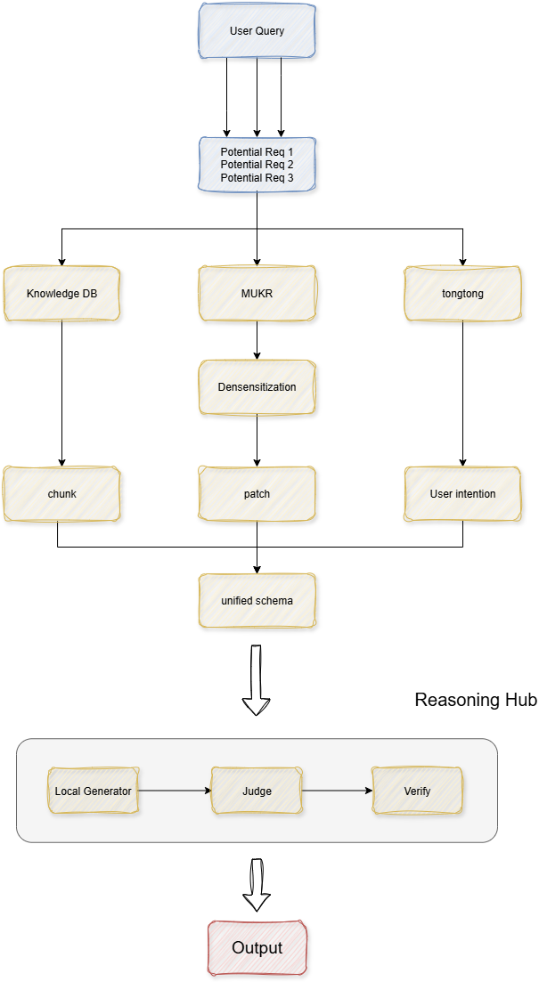
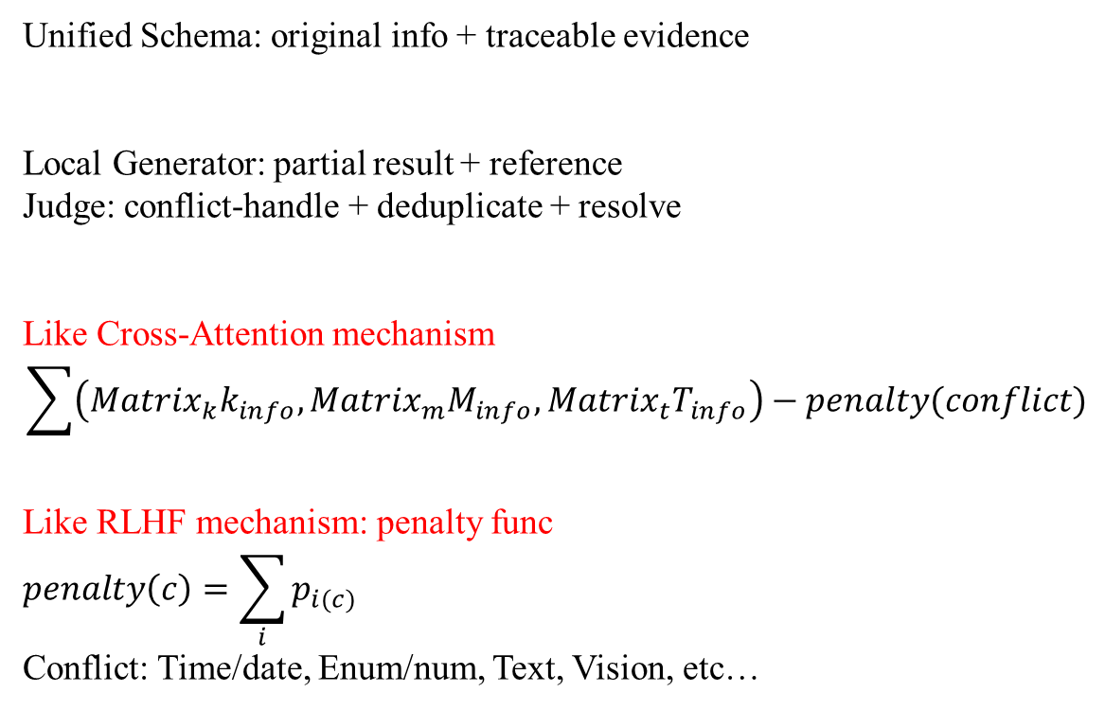
Industry Experience 1
Unified Schema: original info + traceable evidence
Local Generator: partial result + reference
Judge: conflict-handle + deduplicate + resolve
Like Cross-Attention mechanism
$$\sum{\left({Matrix}_{k}k_{info}, {Matrix}_{m}M_{info}, {Matrix}_{t}T_{info}\right)−penalty(conflict)}$$
Like RLHF mechanism: penalty func
$$penalty\left(c\right)=\sum_{i}{p_{i(c)}}$$
Conflict: Time/date, Enum/num, Text, Vision, etc…
Notes:
Multimodal image-text understanding and Knowledge Retrieval —— Achievements, Contribution

Slide 24
Industry Experience 2
Small-parameter Large Language Model: Pre-training and Fine-Tuning
Traditional Small-parameter Intent Recognition
Lack of Generalization
Needs Continuous Update
Not able to Deal with Other Tasks
Small-parameter Large Language Model
Not Need to Continuous Update
Able to Deal with Several Tasks
End to End Efficiency
Saves Computing Resources
Easier to Implement: Smaller Data, Low Risk of Pre-training(Fast Convergence, low overload)
Notes:
Small-parameter Large Language Model: Pre-training and Fine-Tuning —— Overview

Slide 25
Industry Experience 2
Notes:
Small-parameter Large Language Model: Pre-training and Fine-Tuning —— Achievements, Contribution, Technology

Slide 26
Industry Experience
Small-parameter Large Language Model: Pre-training and Fine-Tuning
Notes:
Small-parameter Large Language Model: Pre-training and Fine-Tuning —— Outcome

Slide 27
Future Research Interests
1. Efficient Knowledge Retrieval for Large Language Models
2. Vector Databases and Multimodal Information Integration
3. Scalability and Efficiency in Large Language Models Inference & Deployment

